Slide 1

TCP Concurrent Server to handle Terminated Childs
Parent should catch the
Signal and handle it to
Retrieve Child’s exit status
Client
Server (Parent)
Connect()
Connection
Sockfd
for listen() & accept()
Signal(SIGCHLD, sig_handler){ wait() }
OS sends SIGCHLD signal
to parent on termination
Response
Server (Child)
Sessfd for Communication
Calls _exit(0) on completion

Slide 2
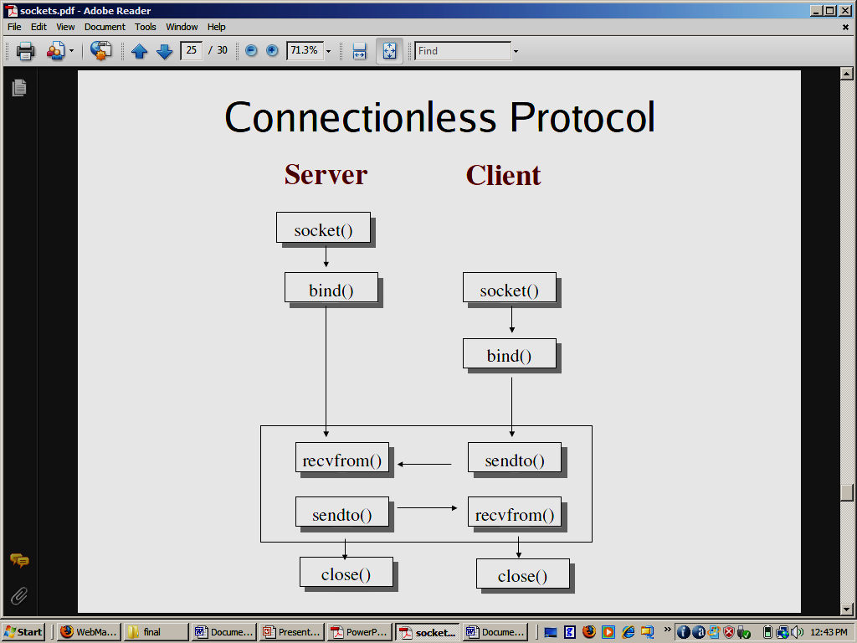
UDP Sockets

Slide 3
sendto() and recvfrom()
int sendto(int sockfd, const void *msg, int len, int flags, const struct sockaddr *to, int tolen);
– to is a pointer to a struct sockaddr which contains the destination IP and port
– tolen is sizeof(struct sockaddr)
int recvfrom(int sockfd, void *buf, int len, int flags, struct sockaddr *from, int *fromlen);
– from is a pointer to a local struct sockaddr that will be filled with IP address and port of the originating machine
– fromlen will contain length of address stored in from

